Slide 1
The Internet Transport Protocols
The Internet has two main protocols in the transport layer, a connectionless protocol and a connection-oriented one. The connectionless protocol is UDP. The connection-oriented protocol is TCP.
Transmission control protocol (TCP) | User datagram protocol (UDP)
TCP is a connection-oriented protocol. Connection-orientation means that the communicating devices should establish a connection before transmitting data and should close the connection after transmitting the data. | UDP is the datagram oriented protocol. This is because there is no overhead for opening a connection, maintaining a connection, and terminating a connection. UDP is efficient for broadcast and multicast types in order of network transmission.
TCP is reliable as it guarantees the delivery of data to the destination router. | The delivery of data to the destination cannot be guaranteed in UDP.
TCP provides extensive error checking mechanisms. It is because it provides flow control and acknowledgement of data. | UDP has only the basic error checking mechanism using checksums.
Sequencing of data is a feature of Transmission Control Protocol (TCP). This means that packets arrive in-order at the receiver. | There is no sequencing of data in UDP. If the order is required, it has to be managed by the application layer.
TCP is comparatively slower than UDP. | UDP is faster, simpler, and more efficient than TCP.

Slide 2
The Internet Transport Protocols
Transmission control protocol (TCP) | User datagram protocol (UDP)
Retransmission of lost packets is possible in TCP, but not in UDP. | There is no retransmission of lost packets in the User Datagram Protocol (UDP).
TCP has a (20-60) bytes variable length header. | UDP has an 8 bytes fixed-length header.
TCP is heavy-weight. | UDP is lightweight.
TCP doesn’t support Broadcasting. | UDP supports Broadcasting.
TCP is used by HTTP, HTTPs, FTP, SMTP and Telnet. | UDP is used by DNS, DHCP, TFTP, SNMP, RIP, and VoIP.

Slide 3
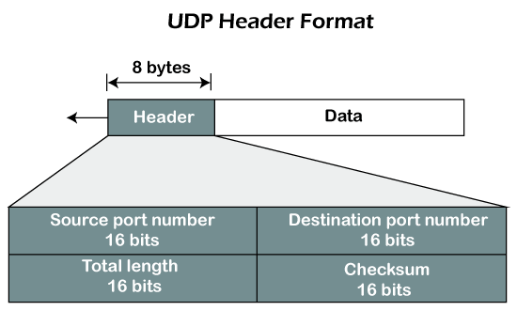
Introduction to UDP
In UDP, the header size is 8 bytes, and the packet size is upto 65,535 bytes.
This packet size is not possible as the data needs to be encapsulated in the IP datagram, and an IP packet, the header size can be 20 bytes; therefore, the maximum of UDP would be 65,535 minus 20.
The size of the data that the UDP packet can carry would be 65,535 minus 28 as 8 bytes for the header of the UDP packet and 20 bytes for IP header.

Slide 4
Introduction to UDP
The source port is primarily needed when a reply must be sent back to the source. By copying the source port field from the incoming segment into the destination port field of the outgoing segment, the process sending the reply can specify which process on the sending machine is to get it.
The UDP length field includes the 8-byte header and the data. The UDP checksum is optional and stored as 0 if not computed (a true computed 0 is stored as all 1s).
It does not support flow control, error control, or retransmission upon receipt of a bad segment. All of that is up to the user processes.
What it does do is provide an interface to the IP protocol with the added feature of demultiplexing multiple processes using the ports. That is all it does.
For applications that need to have precise control over the packet flow, error control, or timing, UDP provides just what the doctor ordered.

Slide 5
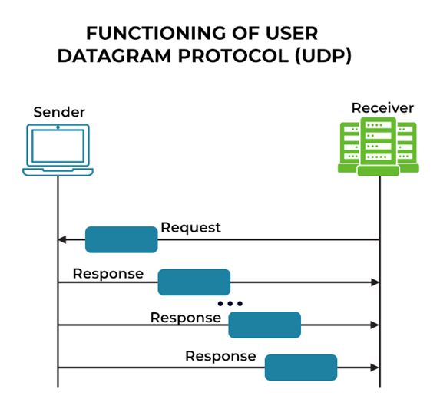
Introduction to UDP

Slide 6
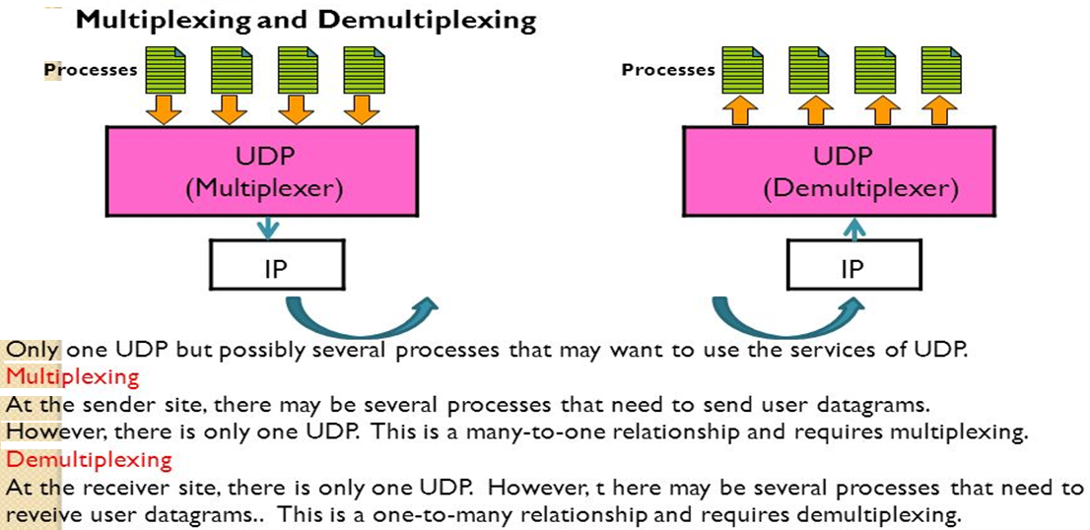
Introduction to UDP

Slide 7
Remote Procedure Call
Sending a message to a remote host and getting a reply back is a lot like making a function call in a programming language.
In both cases you start with one or more parameters and you get back a result. This observation has led people to try to arrange request-reply interactions on networks to be cast in the form of procedure calls.
Such an arrangement makes network applications much easier to program and more familiar to deal with.
For example, just imagine a procedure named get_IP_address (host_name) that works by sending a UDP packet to a DNS server and waiting for the reply, timing out and trying again if one is not forthcoming quickly enough.
When a process on machine 1 calls a procedure on machine 2, the calling process on 1 is suspended and execution of the called procedure takes place on 2. Information can be transported from the caller to the callee in the parameters and can come back in the procedure result.
No message passing is visible to the programmer. This technique is known as RPC (Remote Procedure Call) and has become the basis for many networking applications.
The calling procedure is known as the client and the called procedure is known as the server, and we will use those names here too.

Slide 8
Remote Procedure Call
The idea behind RPC is to make a remote procedure call look as much as possible like a local one.
In the simplest form, to call a remote procedure, the client program must be bound with a small library procedure, called the client stub, that represents the server procedure in the client's address space.
Similarly, the server is bound with a procedure called the server stub. These procedures hide the fact that the procedure call from the client to the server is not local.
Step 1 :is the client calling the client stub. This call is a local procedure call, with the parameters pushed onto the stack in the normal way.
Step 2 : is the client stub packing the parameters into a message and making a system call to send the message. Packing the parameters is called marshaling.
Step 3 : is the kernel sending the message from the client machine to the server machine.
Step 4 is the kernel passing the incoming packet to the server stub.
Step 5 is the server stub calling the server procedure with the unmarshaled parameters. The reply traces the same path in the other direction.

Slide 9
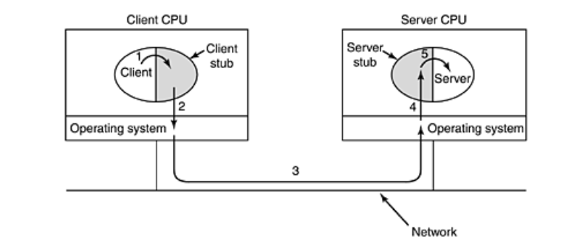
Remote Procedure Call

Slide 10
Remote Procedure Call
RPC stands for Remote Procedure Call. It's a protocol that allows a program to execute code on another address space (commonly on a different computer on a shared network) as if it were a local procedure call. Essentially, RPC enables communication between programs written in different languages or running on different machines.
Client Request: The client application makes a call to a local procedure. This local procedure is actually a stub that acts as a proxy for the remote procedure.
Marshalling: The stub marshals (or serializes) the procedure parameters into a message format that can be sent over the network.
Communication: The message is sent from the client to the server over the network.
Server Reception: The server receives the message and unmarshals (or deserializes) the data into the format required to execute the procedure.
Execution: The server executes the requested procedure.
Response: The result of the procedure execution is marshaled and sent back to the client.

Slide 11
Remote Procedure Call
With RPC, passing pointers is impossible because the client and server are in different address spaces.
In some cases, tricks can be used to make it possible to pass pointers. Suppose that the first parameter is a pointer to an integer, k. The client stub can marshal k and send it along to the server.
The server stub then creates a pointer to k and passes it to the server procedure, just as it expects. When the server procedure returns control to the server stub, the latter sends k back to the client where the new k is copied over the old one, just in case the server changed it.
In effect, the standard calling sequence of call-by-reference has been replaced by copy-restore. Unfortunately, this trick does not always work, for example, if the pointer points to a graph or other complex data structure. For this reason, some restrictions must be placed on parameters to procedures called remotely.
A second problem is that in weakly-typed languages, like C, it is perfectly legal to write a procedure that computes the inner product of two vectors (arrays), without specifying how large either one is. Each could be terminated by a special value known only to the calling and called procedure. Under these circumstances, it is essentially impossible for the client stub to marshal the parameters: it has no way of determining how large they are.
A third problem is that it is not always possible to deduce the types of the parameters, not even from a formal specification or the code itself.

Slide 12
Remote Procedure Call
An example is printf, which may have any number of parameters (at least one), and the parameters can be an arbitrary mixture of integers, shorts, longs, characters, strings, floating-point numbers of various lengths, and other types.
A fourth problem relates to the use of global variables. Normally, the calling and called procedure can communicate by using global variables, in addition to communicating via parameters.
If the called procedure is now moved to a remote machine, the code will fail because the global variables are no longer shared. These problems are not meant to suggest that RPC is hopeless. Of course, RPC need not use UDP packets, but RPC and UDP are a good fit and UDP is commonly used for RPC.
However, when the parameters or results may be larger than the maximum UDP packet or when the operation requested is not idempotent, it may be necessary to set up a TCP connection and send the request over it rather than use UDP.
RPC is used in various contexts and can be implemented using different technologies, such as:
JSON-RPC and XML-RPC: Lightweight protocols that use JSON(JavaScript Object Notation) or XML(Extensible Markup Language ) for data interchange.
gRPC: A high-performance RPC framework developed by Google that uses HTTP/2 (Hypertext Transport Protocol) for transport, Protocol Buffers for serialization, and supports multiple programming languages.
SOAP (Simple Object Access Protocol ) : A protocol for exchanging structured information in web services using XML.
RPC simplifies network communication by abstracting the details of the network interactions, making distributed systems easier to develop and maintain.

Slide 13
The Real-Time Transport Protocol
RTP stands for Real-time Transport Protocol. It's a network protocol designed for delivering audio and video over IP networks in real-time. RTP is commonly used in streaming media systems, video conferencing, and VoIP (Voice over Internet Protocol) applications.
How RTP Works:
Packetization: RTP breaks down media streams (audio or video) into packets. Each RTP packet contains a payload (the actual media data) and a header that includes information like sequence numbers and timestamps.
Transport: RTP packets are typically sent over UDP (User Datagram Protocol) because UDP provides low-latency transport, which is crucial for real-time applications. However, RTP itself does not guarantee delivery, ordering, or error recovery.
Synchronization: RTP uses timestamps to synchronize packets. This is especially important for maintaining synchronization between audio and video streams.
Payload Types: RTP headers include a payload type field that indicates the type of media data (e.g., audio codec, video format). This allows the receiving application to correctly interpret and decode the payload.

Slide 14
The Real-Time Transport Protocol
Key Features of RTP:
Sequence Numbers: Help detect packet loss and restore the correct order of packets.
Timestamps: Allow synchronization of different media streams and compensate for network delays.
Payload Type: Identifies the format of the media data to facilitate proper decoding.
Real-time: Optimized for low latency, making it suitable for live streaming and interactive applications.
RTP vs. RTCP:
RTP is often used in conjunction with RTCP (Real-time Transport Control Protocol). While RTP handles the actual delivery of media data, RTCP provides feedback on the quality of the transmission, including information on packet loss, jitter, and delay. This feedback helps adjust and optimize the performance of the RTP stream.
In summary, RTP is crucial for applications that require real-time media delivery, ensuring that audio and video are transmitted with minimal delay and in a synchronized manner.

Slide 15
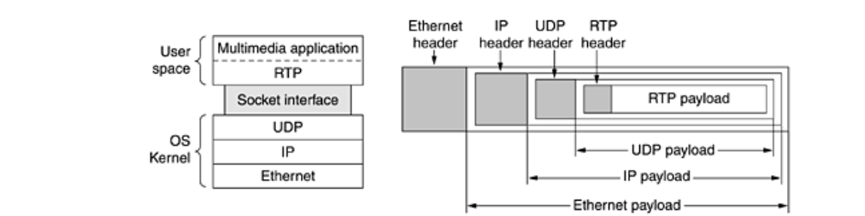
The Real-Time Transport Protocol

Slide 16
The Real-Time Transport Protocol
The basic function of RTP is to multiplex several real-time data streams onto a single stream of UDP packets.
The UDP stream can be sent to a single destination (unicasting) or to multiple destinations (multicasting). Because RTP just uses normal UDP, its packets are not treated specially by the routers unless some normal IP quality-of-service features are enabled.
In particular, there are no special guarantees about delivery, jitter, etc. Each packet sent in an RTP stream is given a number one higher than its predecessor.
This numbering allows the destination to determine if any packets are missing. If a packet is missing, the best action for the destination to take is to approximate the missing value by interpolation.
Retransmission is not a practical option since the retransmitted packet would probably arrive too late to be useful. As a consequence, RTP has no flow control, no error control, no acknowledgements, and no mechanism to request retransmissions.

Slide 17
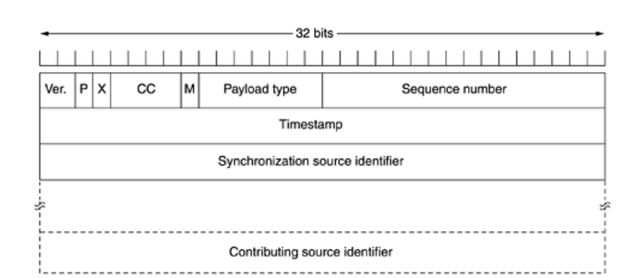
The Real-Time Transport Protocol-Header

Slide 18
The Real-Time Transport Protocol-Header
It consists of three 32-bit words and potentially some extensions. The first word contains the Version field, which is already at 2. Let us hope this version is very close to the ultimate version since there is only one code point left 32 bits.
The P (Padding) bit indicates that the packet has been padded to a multiple of 4 bytes. The last padding byte tells how many bytes were added. The X bit indicates that an extension header is present.
The CC field tells how many contributing sources are present, from 0 to 15.
The M bit is an application-specific marker bit. It can be used to mark the start of a video frame, the start of a word in an audio channel, or something else that the application understands.
The Payload type field tells which encoding algorithm has been used (e.g., uncompressed 8-bit audio, MP3, etc.). Since every packet carries this field, the encoding can change during transmission.
The Sequence number is just a counter that is incremented on each RTP packet sent. It is used to detect lost packets.
The timestamp is produced by the stream's source to note when the first sample in the packet was made. This value can help reduce jitter at the receiver by decoupling the playback from the packet arrival time.

Slide 19
The Real-Time Transport Protocol-Header
The Synchronization source identifier tells which stream the packet belongs to. It is the method used to multiplex and demultiplex multiple data streams onto a single stream of UDP packets. Finally, the Contributing source identifiers, if any, are used when mixers are present in the studio.
RTP has a little sister protocol (little sibling protocol?) called RTCP (Realtime Transport Control Protocol). It handles feedback, synchronization, and the user interface but does not transport any data. The first function can be used to provide feedback on delay, jitter, bandwidth, congestion, and other network properties to the sources.
This information can be used by the encoding process to increase the data rate (and give better quality) when the network is functioning well and to cut back the data rate when there is trouble in the network.
By providing continuous feedback, the encoding algorithms can be continuously adapted to provide the best quality possible under the current circumstances.
For example, if the bandwidth increases or decreases during the transmission, the encoding may switch from MP3 to 8-bit PCM to delta encoding as required. The Payload type field is used to tell the destination what encoding algorithm is used for the current packet, making it possible to vary it on demand.
RTCP also handles interstream synchronization. The problem is that different streams may use different clocks, with different granularities and different drift rates. RTCP can be used to keep them in sync.
Finally, RTCP provides a way for naming the various sources (e.g., in ASCII text).

